Slide 1
Opening an Italian restaurant
Coursera Capstone Project

Slide 2
Business problem
Find out the best location in Ljubljana to open a new restaurant
Main objectives:
type of restaurant
district of a new restaurant

Slide 3
Data
Parameters that have an impact on the decision:
list of districts in Ljubljana
number of the most numerous tourists in Ljubljana
location of the most important sights in Ljubljana
number of restaurants which offer dishes from the country as the most numerous tourists are coming
list of chosen type of restaurants situated in the city district

Slide 4
Methodology
web scraping to get the data of Ljubljana districts
Nominatim-OpenStreetMap API helped me to get latitudes and longitudes of the districts
Nominatim geolocator to get Ljubljana coordinates
Foursquare API to find all Italian restaurant in Ljubljana
K-means clustering algorithm to find out centroid of Ljubljana sights and Italian restaurants in district “Center”
Folium library to visualize all findings

Slide 5
Tourists in Ljubljana
Tourist arrivals & overnights - TOP 8 countries (2008-2017)
Italians are the most numerous tourists in Ljubljana

Slide 6
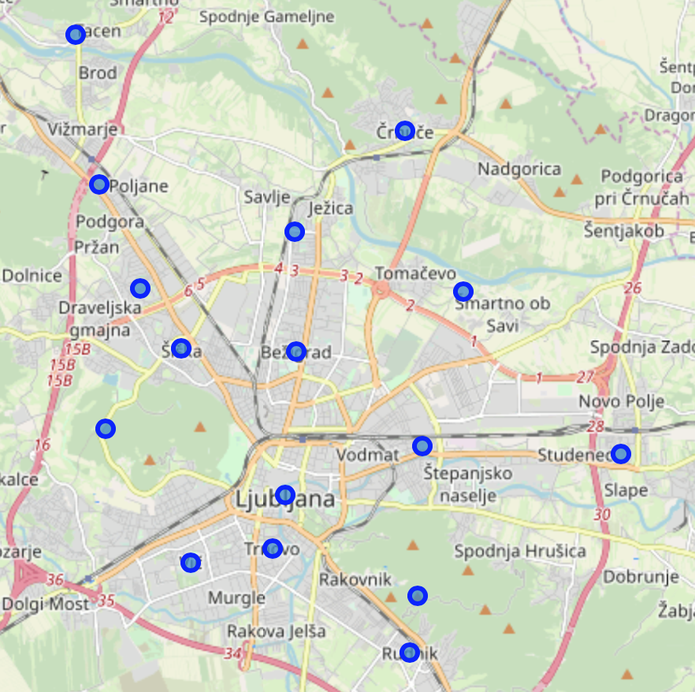
Districts in Ljubljana
Districts | Latitude | Longitude
Bežigrad | 46,071523 | 14,509137
Center | 46,049815 | 14,506782
Črnuče | 46,105006 | 14,532862
Dravlje | 46,08114 | 14,475201
Golovec | 46,034705 | 14,535686
Jarše | 46,080596 | 14,5456
Moste | 46,057282 | 14,536756
Polje | 46,056122 | 14,580008
Posavje | 46,089738 | 14,508915
Rožnik | 46,05999 | 14,46779
Rudnik | 46,025988 | 14,533932
Sostro | 46,035488 | 14,607094
Šentvid | 46,096834 | 14,466245
Šiška | 46,071956 | 14,484203
Šmarna gora | 46,119496 | 14,4611
Trnovo | 46,041719 | 14,503884
Vič | 46,039693 | 14,486204

Slide 7
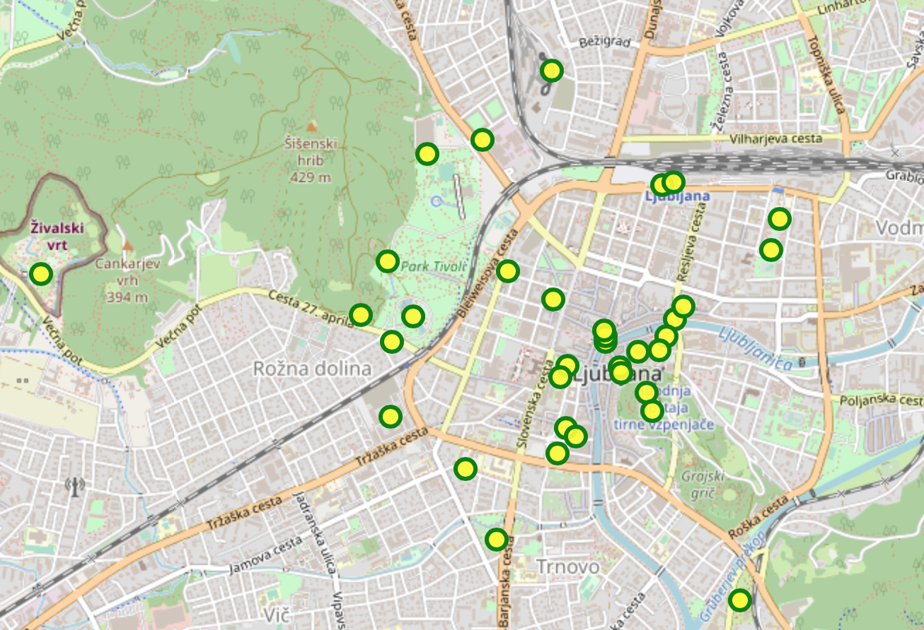
Sights inLjubljana
Ljubljana Castle | National Museum of Contemporary History
Triple Bridge | Congress Square
Tivoli City park | The Skyscraper (Neboticnik)
Dragon Bridge | Botanic Garden
Presern monument | Brewery Museum
Robba Fountain | Tivoli Castle
Krizanke | Vodnik Square
Metelkova | Slovenian Railway Museum
Ljubljana Central Market | Slovenian Ethnographic Museum
National and University Library | The House of experiments
Town Hall | Museum of Illusions
Plecnik House | Muro Romano
Zoo | Monument The Fish
Cathedral | Bus Station & Railway Station
Franciscan Church of the Annunciation | Slovene Geographical Museum
National Gallery | Tobacco Museum
National Museum of Slovenia | Castle hill and Plecnik Sance

Slide 8
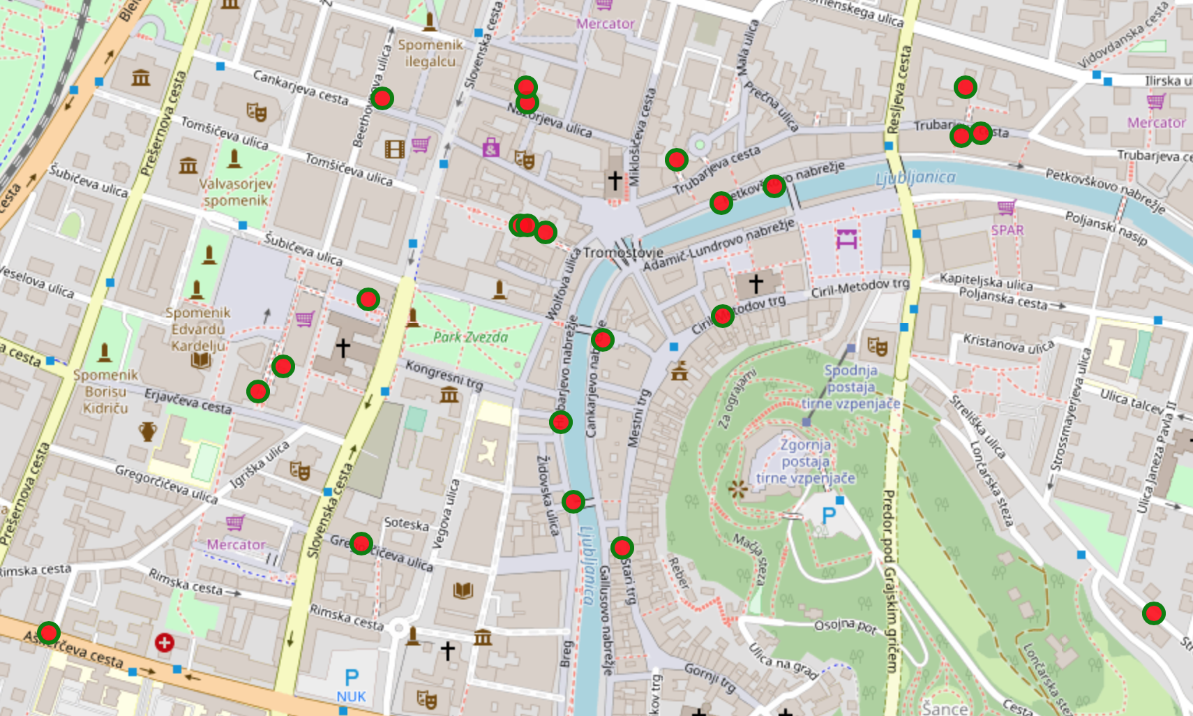
Italian restaurants in district “Center”
District | Italian restaurants
Bežigrad | 6
Center | 32
Dravlje | 4
Golovec | 1
Jarše | 1
Moste | 4
Polje | 1
Posavje | 4
Rudnik | 2
Trnovo | 1
Vič | 5
Črnuče | 3
Šiška | 2
Šmarna gora | 1

Slide 9
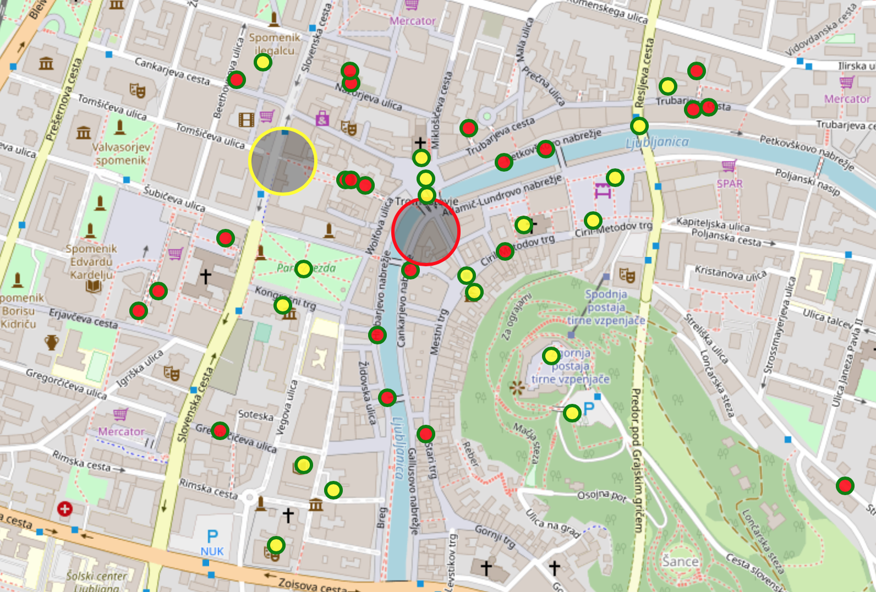
Results
Centroids of Ljubljana sights and Italian restaurants in district “Center”

Slide 10
Conclusion
Foursquare API realize to determine main objectives:
the type of the restaurant
classification of city district
With the correlation between two centroids (sights and Italian restaurants) which are located in the same district, indicates that district “Center” is the best district to open new Italian restaurant.

